Slide 1


Accenture: -
Data Analytics
and Visualization

Slide 2


Tasks: -
Project recap
Problem
The Analytics team
Process
Insights
Summary
Notes:
The project is to find the highest amount of counts scored in the category section.
For this the given dataset has to be read, cleaned and visualized to find the highest category section.

Slide 3

The team has been associated to a new project – “Social Buzz.”
The Data refers to the relevant data sources that you will clean, process, and use to generate interesting insights for the business.
An analysis has to be done to find out about ”content categories” showing the top 5 categories with the largest popularity.
Project Recap

Slide 4

Problem
There is a lot of information on the dataset which makes it complex for analysis.
As per the data, 10000 posts has been received in every dataset reaction types, content and reactions.
So the dataset has to cleaned in order to reduce it from complex to simple state
Notes:
The problem with the dataset is that per day 10000 posts has been given for all categories with multiple content, reaction and reaction types.

Slide 5
Chief Technology Architect
Andrew Fleming
The Analytics team
Senior Principal
Marcus Rompton
Data Analyst
Yashwant Jangid

Slide 6
Process
1. Data Understanding
2. Data Cleaning
3. Data Modelling
4. Data Analysis
5. Data Insights

Slide 7

Insights
In the given data set, we find out that there are 29 different categories which consists of animals, fitness, science, cooking, culture and so on.
It is being observed that animals is the dataset with highest category containing a score of above 70000.

Slide 8
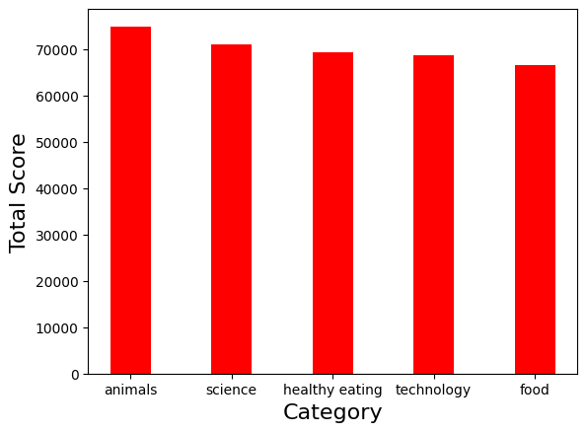
Notes:
As we can clearly state that animals is the category with the highest score of above 70000.

Slide 9
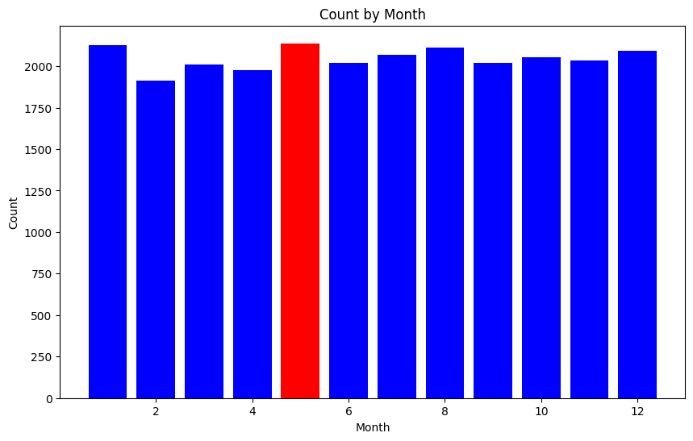
Notes:
The month of may has the highest number of posts.

Slide 10

From the dataset, the columns which create complexity are removed and reduced.
We can clearly state that from the total score and category chart animals attract the highest score.
And from the month and post data, people use the highest during the month of May.
Summary

Slide 11

Thank you!
ANY QUESTIONS?

